Slide 1


Hemorrhoidal disease: are we really getting better?
Gaetano Gallo MD PhD FASCRS FEBS (Coloproctology)
Colorectal Surgery Unit, IRCCS San Raffaele Scientific Institute, Vita-Salute University, Milan, Italy
gallo.gaetano@hsr.it

Slide 2
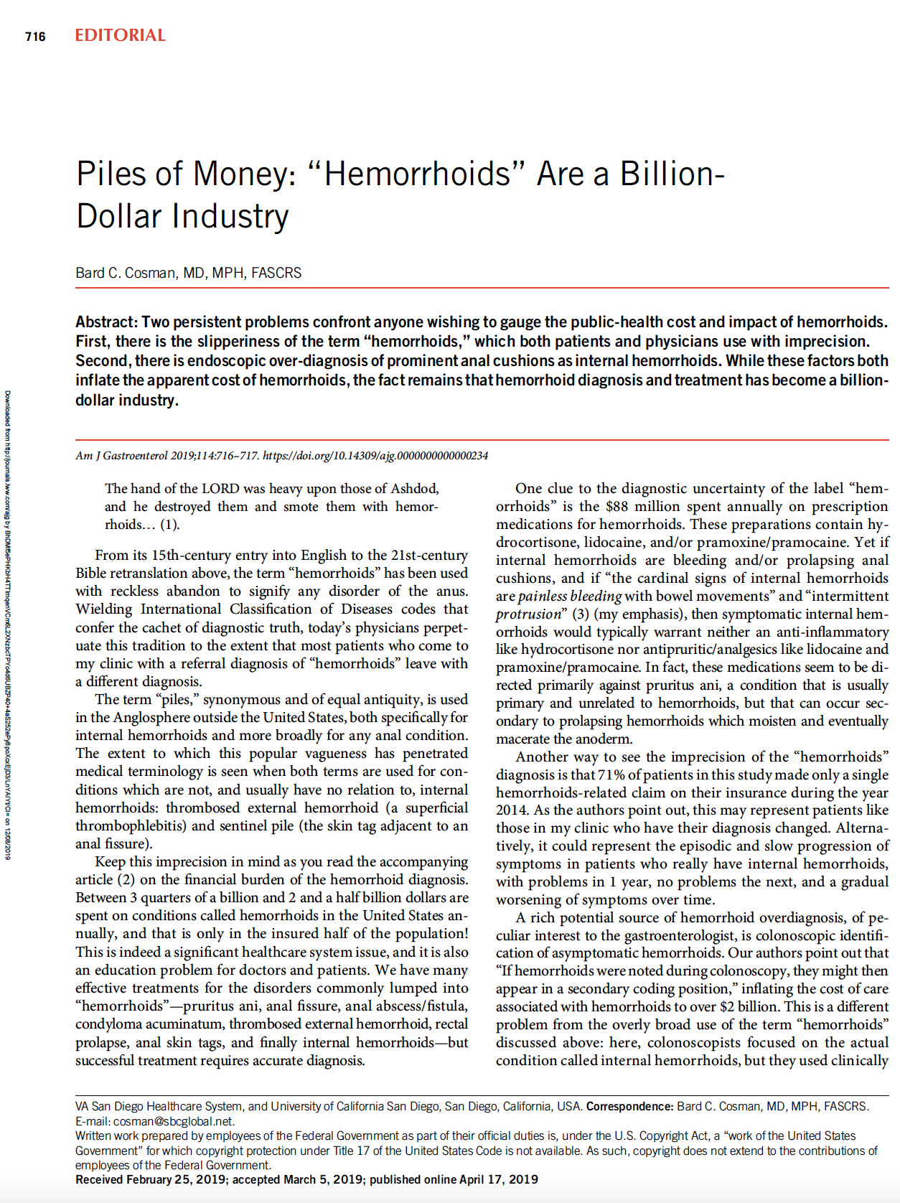

Slide 3


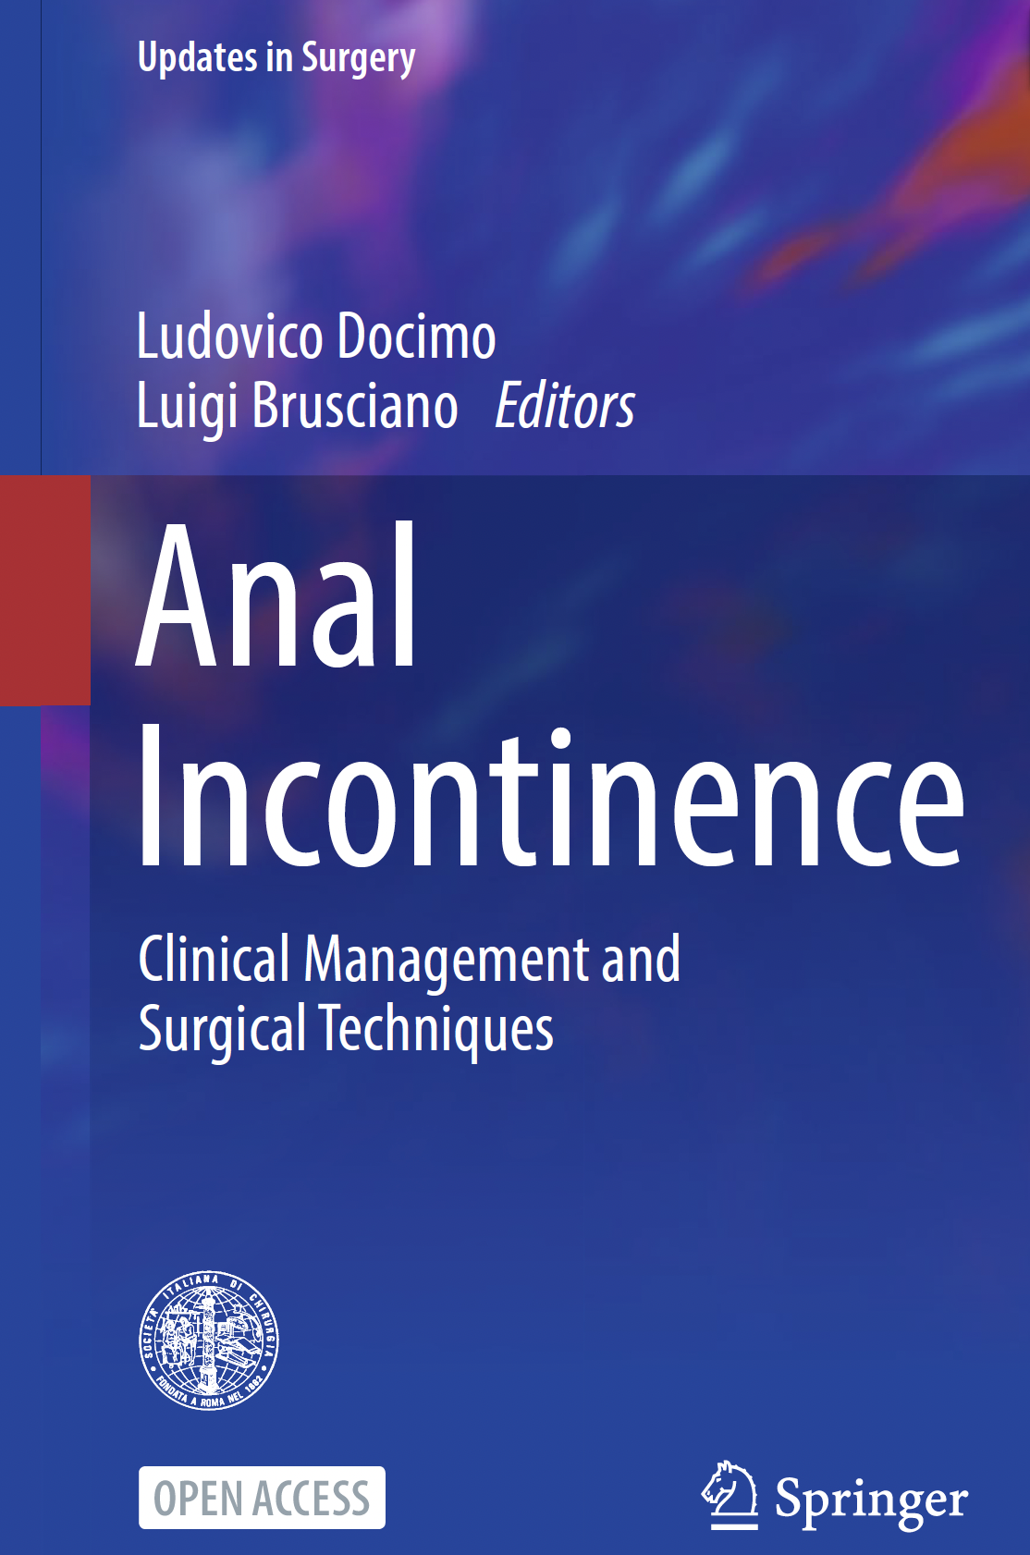
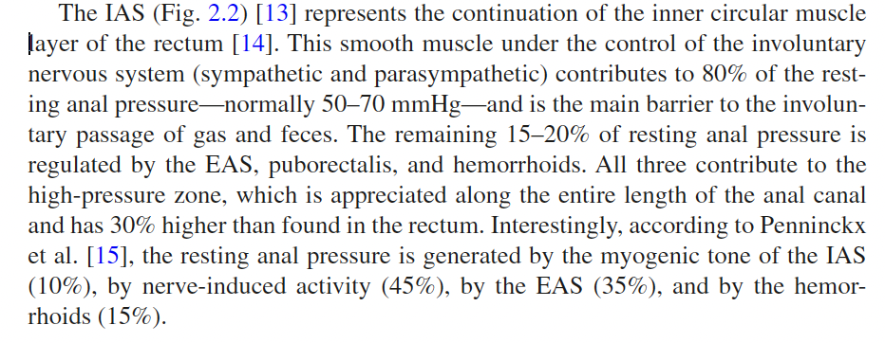
Notes:
Hemorrhoids are physiological structures and should be preserved

Slide 4
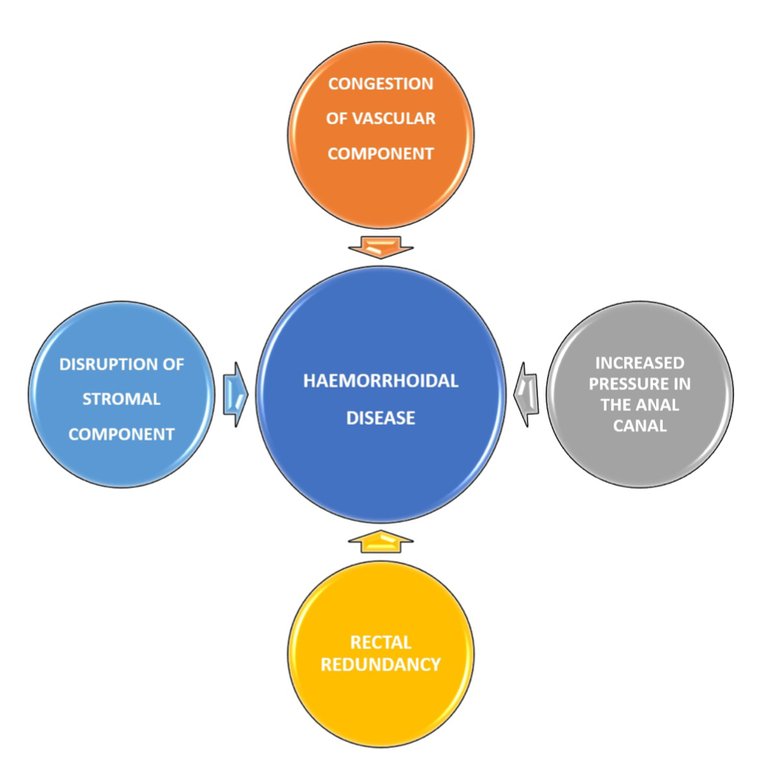
Notes:
These changes include abnormal venous dilatation, vascular thrombosis, degenerative process in the collagen fibers and fibroelastic tissues, distortion and rupture of the anal subepithelial muscle (Figure 2). In addition to the above findings, a severe inflammatory reaction involving the vascular wall and surrounding connective tissue has been demonstrated in hemorrhoidal specimens, with associated mucosal ulcer- ation, ischemia and thrombosis

Slide 5
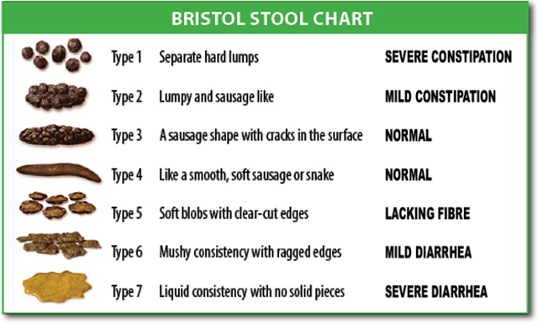

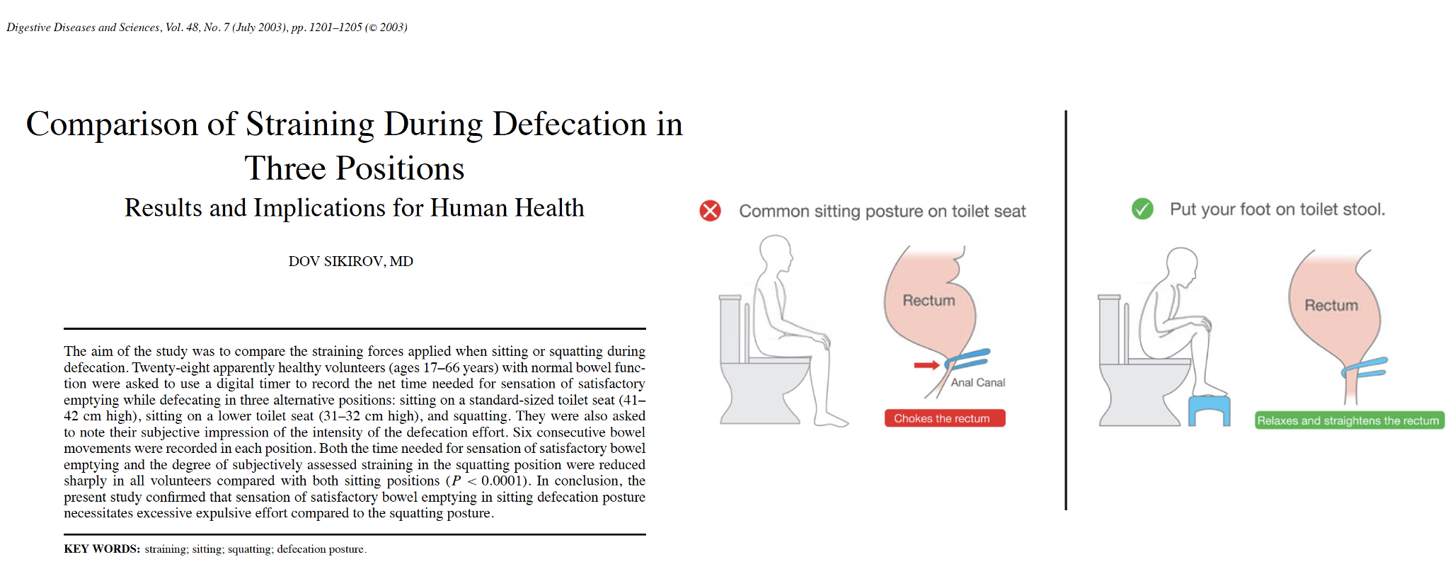
Notes:
balanced diet with adequate fiber and oral fluid intake may improve stool consistency and is one of the main pur- poses of lifestyle changes of the conservative treatment for
HD. Constipation and in particular hard stool usually worsen symptoms related to the hemorrhoidal prolapse. A regular defecation with type 3 or 4 stool, according to the Bristol Stool Form Scale [38], without prolonged time on the toilet, to avoid straining during attempted defecation, may improve symptoms. Furthermore, the addition of anti-inflammatory agents or local steroids may be an effective first-line treat- ment and it should also be suggested as bridge to surgery.

Slide 6
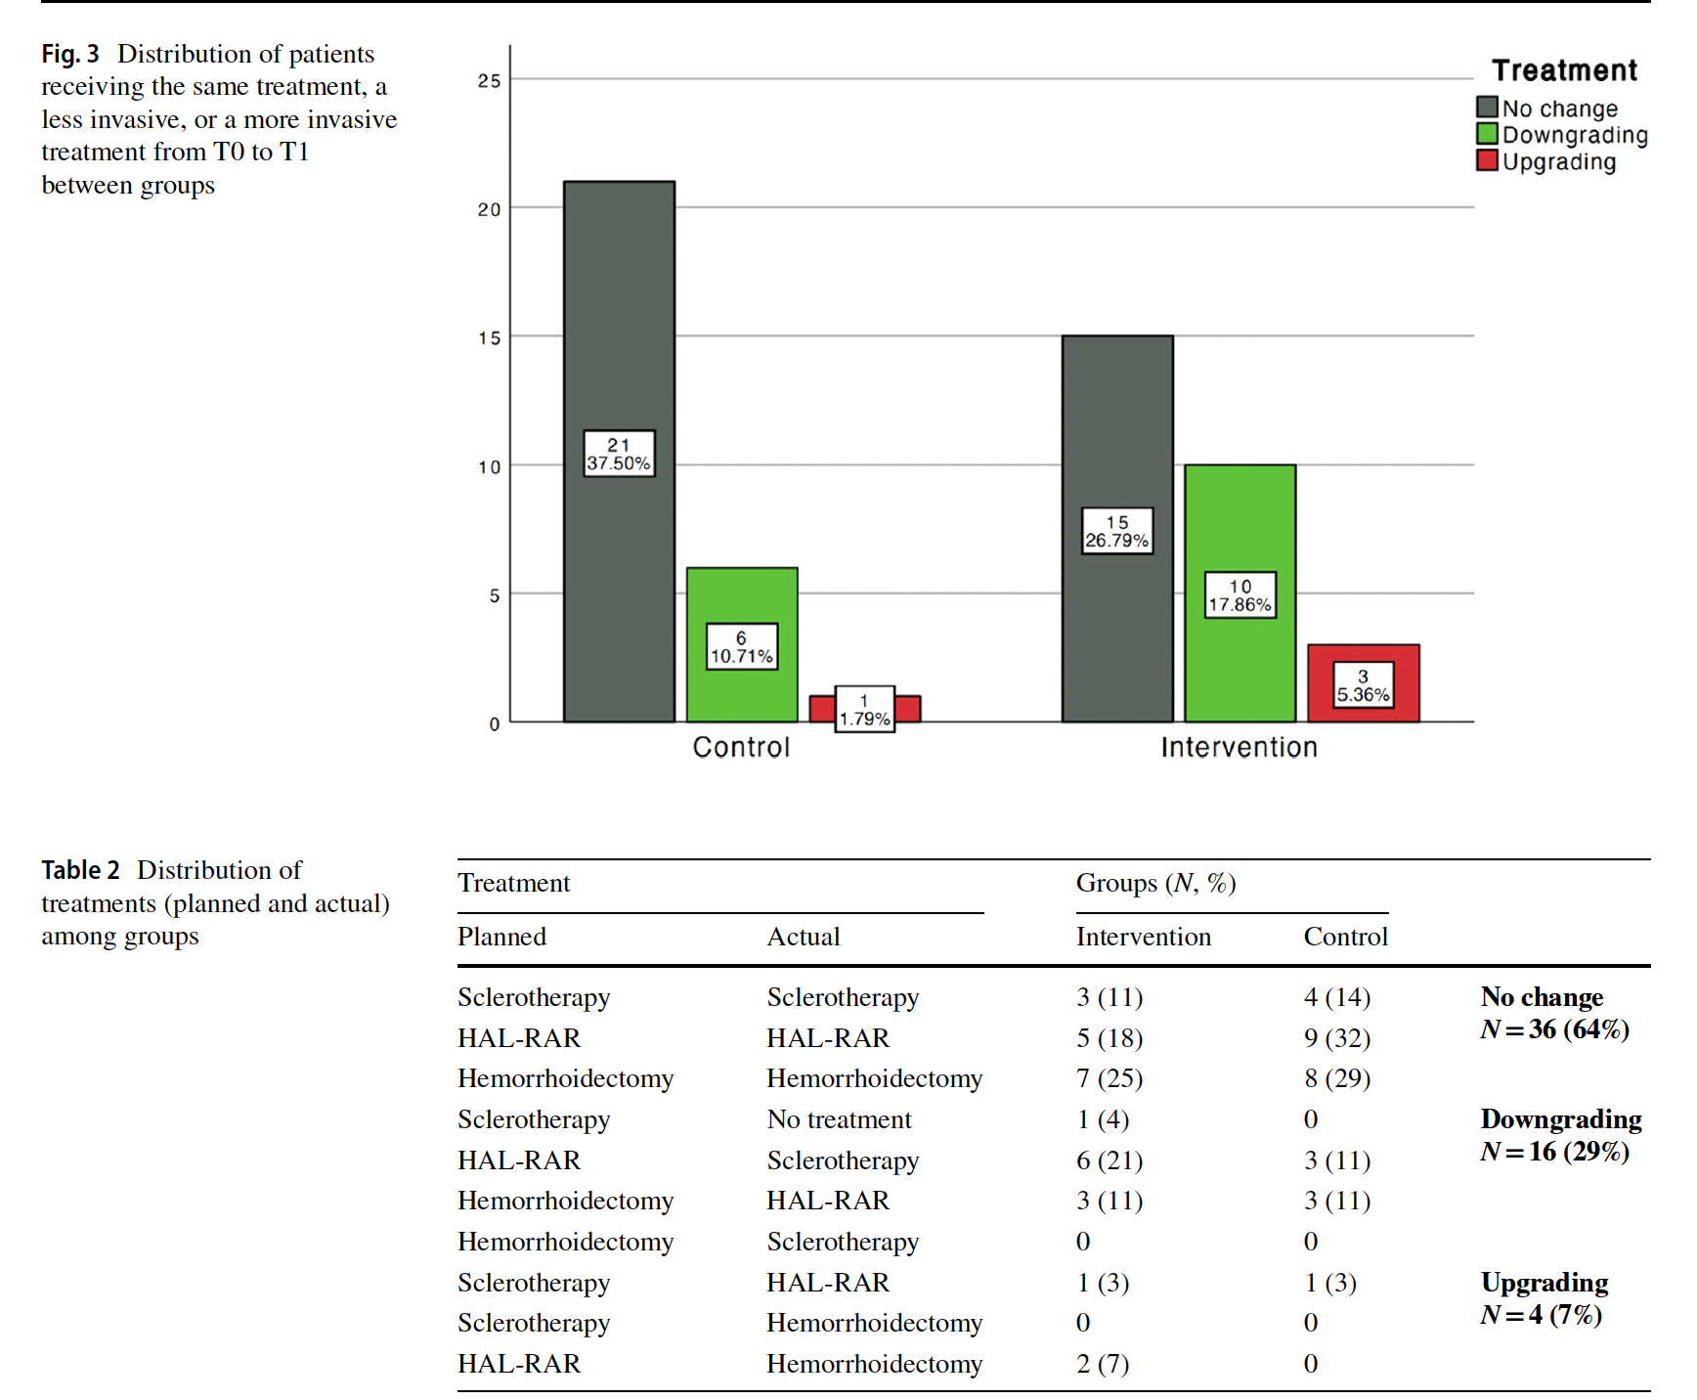
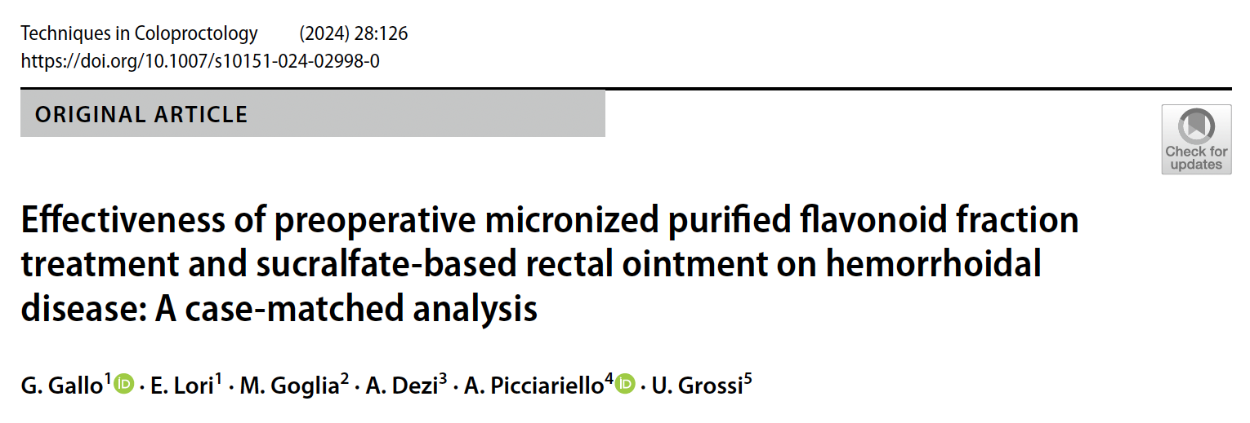
Notes:
Compared with the control group, a higher proportion of patients in the intervention group received less invasive treatment from T0 to T1 (10 [18%] versus 6 [11%]; Fig. 3).
The planned treatment at T0 aligned with the actual treatment at T1 for 36 (64%) patients (Table 2). Only four patients underwent a more invasive treatment, with three in the intervention group (from HAL-RAR to hemorrhoidectomy [n = 2] or from sclerotherapy to HAL-RAR [n = 1]) and one in the control group (from sclerotherapy to HAL-RAR).

Slide 7
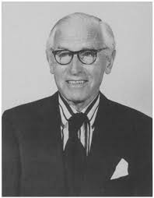
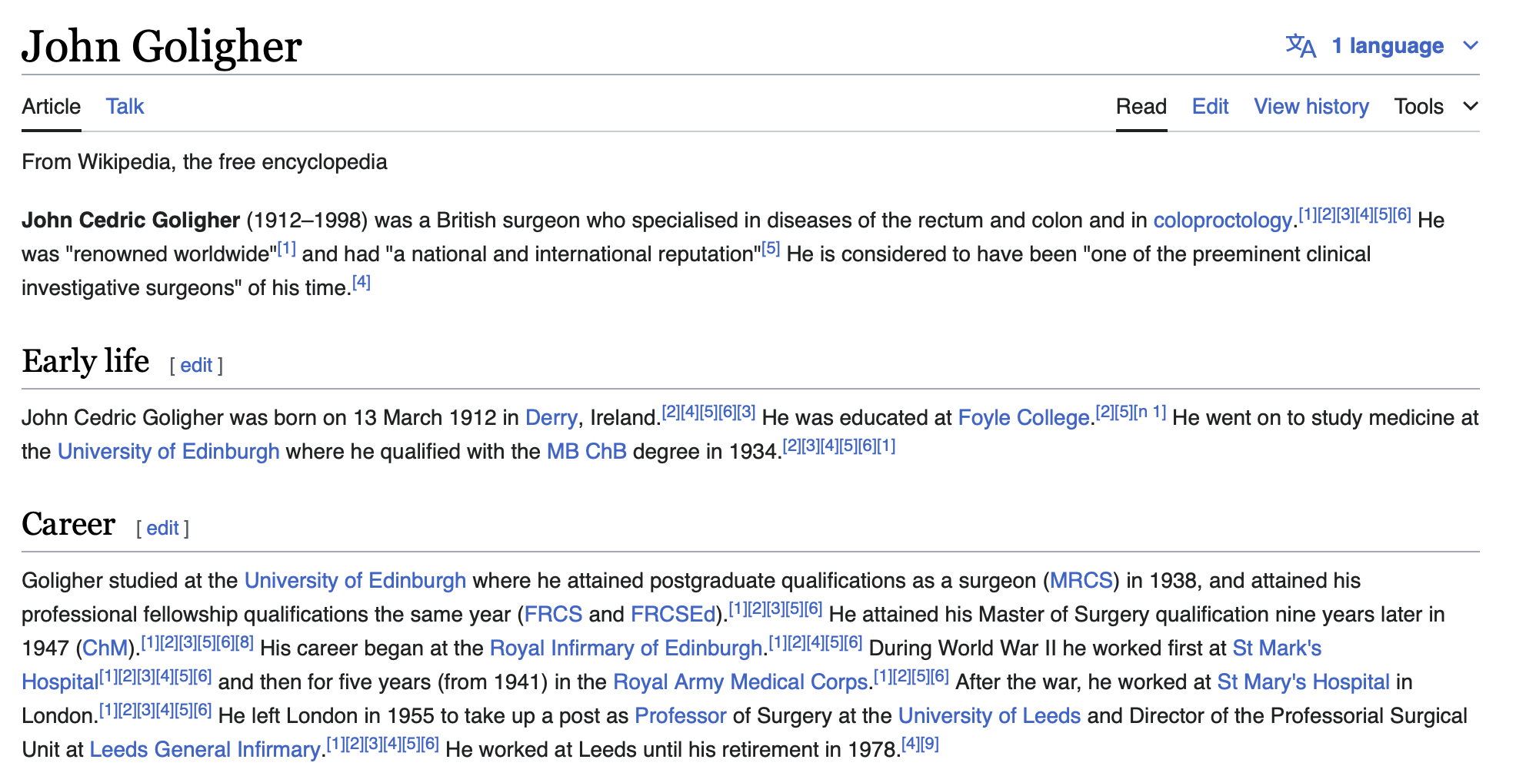
Campos FG, Nahas SC, Cecconello I. The life of John Cedric Goligher (1912-1998) revisited. J Med Biogr. 2016 Aug;24(3):380-3. doi: 10.1177/0967772014532896. Epub 2014 Jun 26. PMID: 24972616.

Slide 8

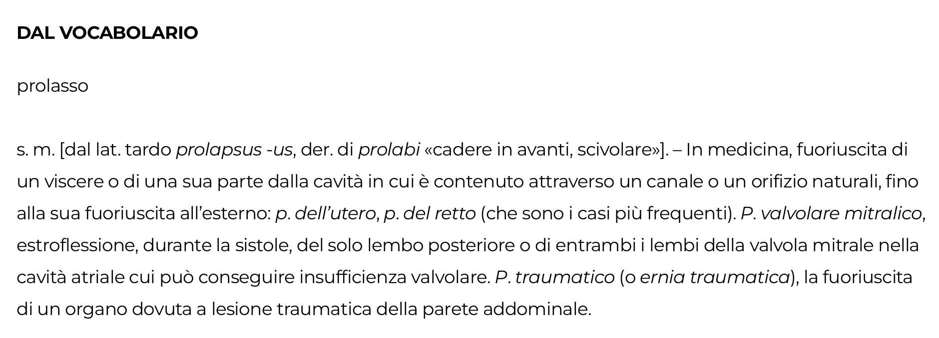

Slide 9
Painless rectal bleeding
Anal Pain
Oedema
Itching
Thrombosis
Notes:
Perchè? Leggere.
La classificazione descrive solo un sintomo, IL PROLASSO, e non tiene in considerazione il numero di piles affected oltre a quanto prima menzionato.
Pur stimando la gravità del prolasso, non sempre un maggior grado corrisponde ad un maggior burden/impatto sulla qualità di vita del paziente.

Slide 10
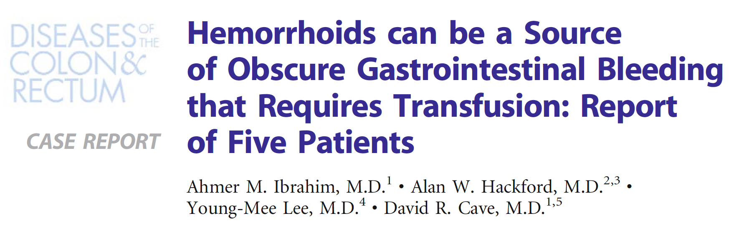
Five patients, who presented with severe hematochezia or obscure gastrointestinal bleeding, during a 24-month period had had an extensive workup for gastrointestinal bleeding. All had required transfusion of 2 units or more of blood.
«....multigroup, engorged, internal, and external hemorrhoidal disease..»
Notes:
Hemorrhoids can be a source of obscure gastrointestinal bleeding that requires transfusion as reported in this study including
For this reason a sympatomatic approach is useful

Slide 11
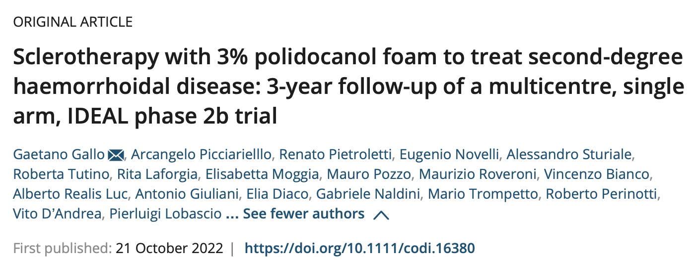

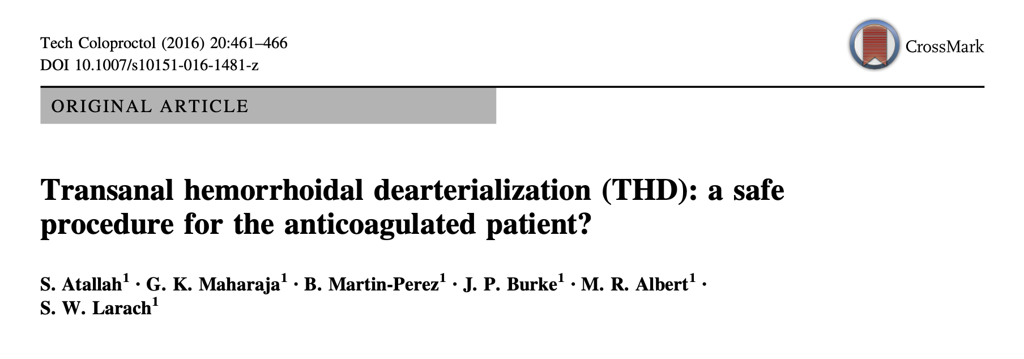
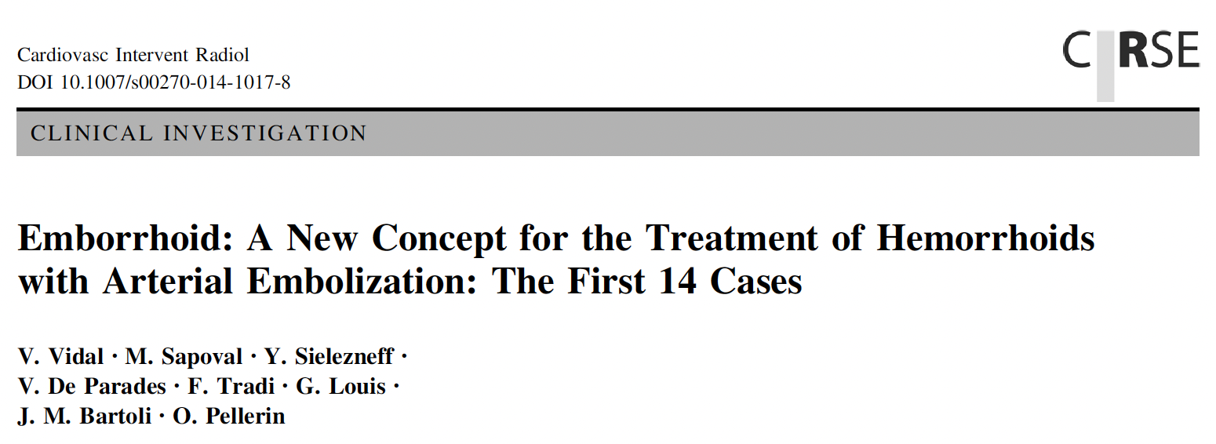

Slide 12
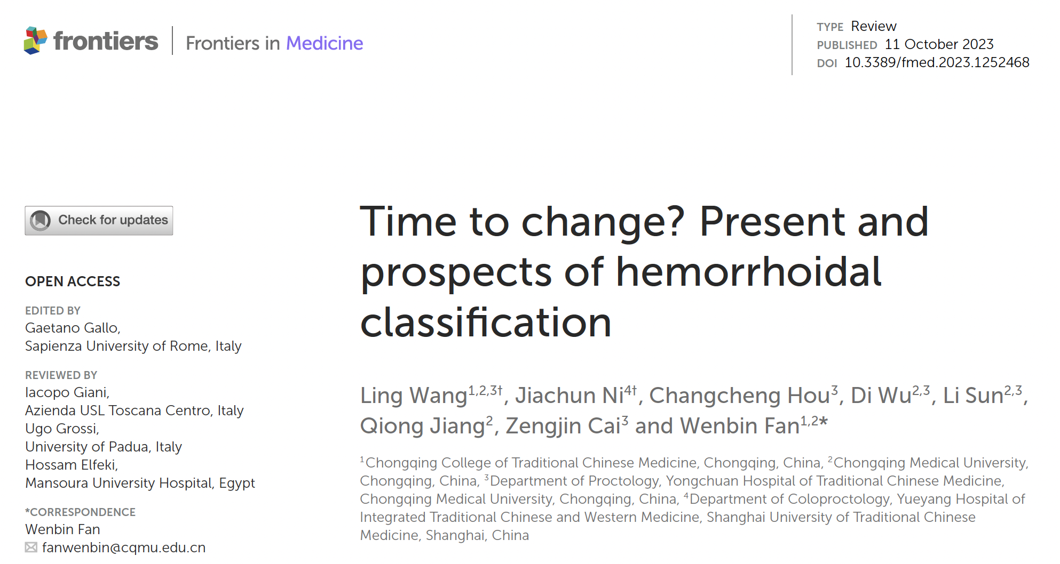


Slide 13
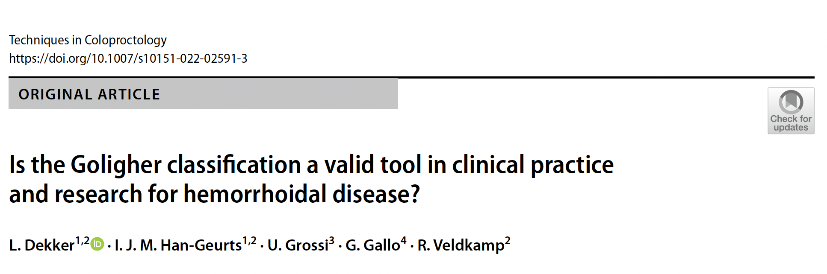
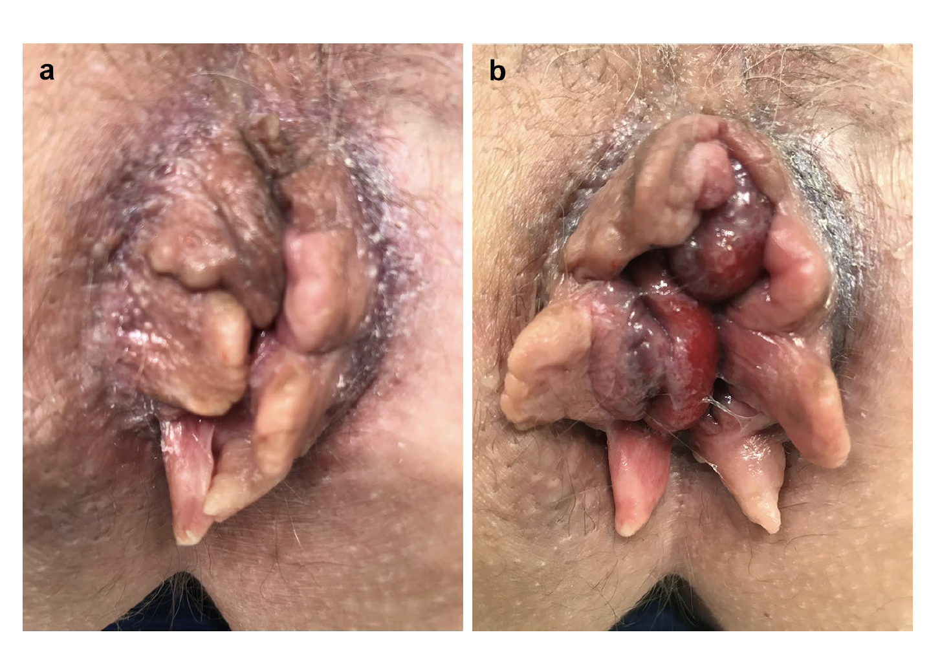
Photographs used in the survey, during rest (a) and strain (b)
The patient case in the survey described a 52-year-old women with daily complaints of soiling and blood loss. She wears a panty liner. She is aware of a prolapse but that is not her main concern and she does not manually reduce it. There are no complaints of itching or pain.
Grade I; 1 (1%),
Grade II; 41 (43%)
Grade III; 43 (45%)
Grade IV; 10 (11%)
Notes:
a 52-year-old women with daily complaints of soiling and blood loss. She wears a panty liner. She is aware of a prolapse but that is not her main concern and she does not manually reduce it. There are no complaints of itching or pain
According to the definitions in the Goligher classification, the differentiation between grade II and III HD mainly depends on the patients’ medical history (manual reduction), as prolapse and reducibility cannot always be achieved at physical examination.
If we were to base our analysis on Goligher's classification, i.e., prolapse, this clinical scenario corresponds to grade II hemorrhoidal disease because the prolapse is spontaneously reducible.
However, given the presence of an external component, i.e., skin tags, may have had an influence on the evaluation

Slide 14
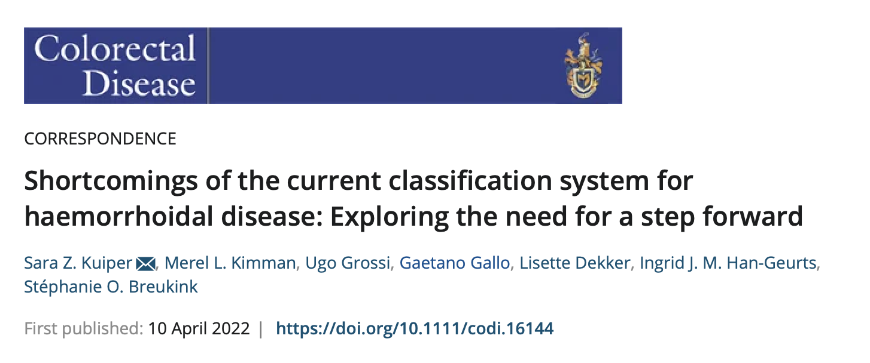
An online survey among European Society of Coloproctology members was disseminated and completed by 81 members (77% male), predominantly colorectal surgeons (71%), from 34 different countries
For grade II–III HD, 82% of members reported that symptoms were used to decide on the most appropriate procedure.
A proctoscopy, the Goligher grading and medical history were each also used by approximately 40% of members.
Other factors influencing treatment decision were circumferential prolapse, faecal incontinence, single pile and evacuation disorder.

Slide 15
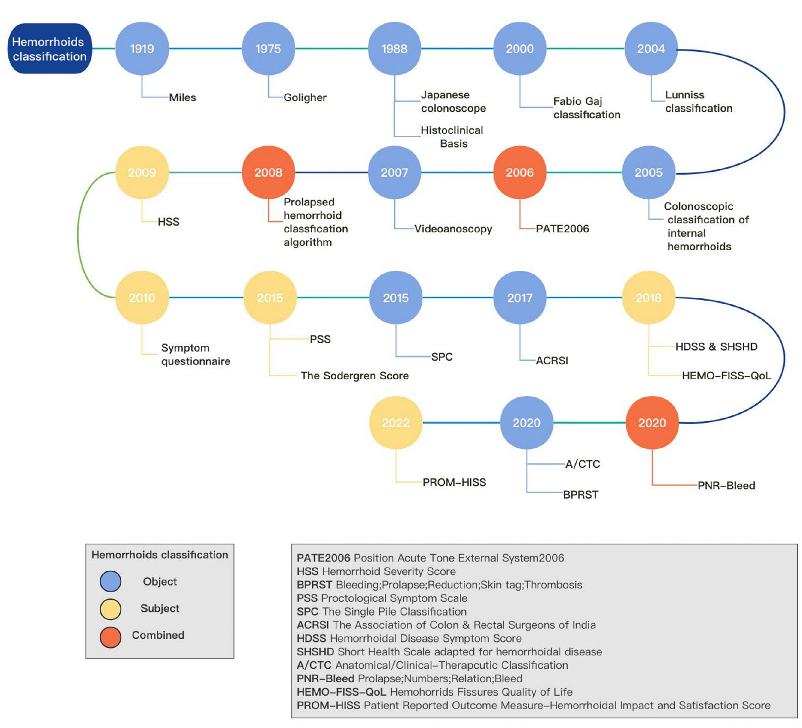
The new classification of hemorrhoids: PATE 2000-Sorrento. History of the scientific debate
Gaj F et al.
Prospective evaluation of stapled haemorrhoidopexy versus transanal haemorrhoidal dearterialisation for stage II and III haemorrhoids: three-year outcomes
Giordano P et al.
The single pile classification: a new tool for the classification of haemorrhoidal disease and the comparison of treatment results
Elbetti C, Giani I, … Martellucci J
New Anatomical/Clinical-Therapeutic Classification (A/CTC)
Naldini G et al.
Notes:
Satisfaction with treatment
New Anatomical/Clinical-Therapeutic Classification (A/CTC
Position Acute Tone External
(PATE) 2006

Slide 16

Symptomatic
Tailored
Notes:
In the era of symptomatic and tailored treatment, discussion with the patient is crucial.
More and more often we are moving towards a conservative and minimally invasive approach for several reasons

Slide 17
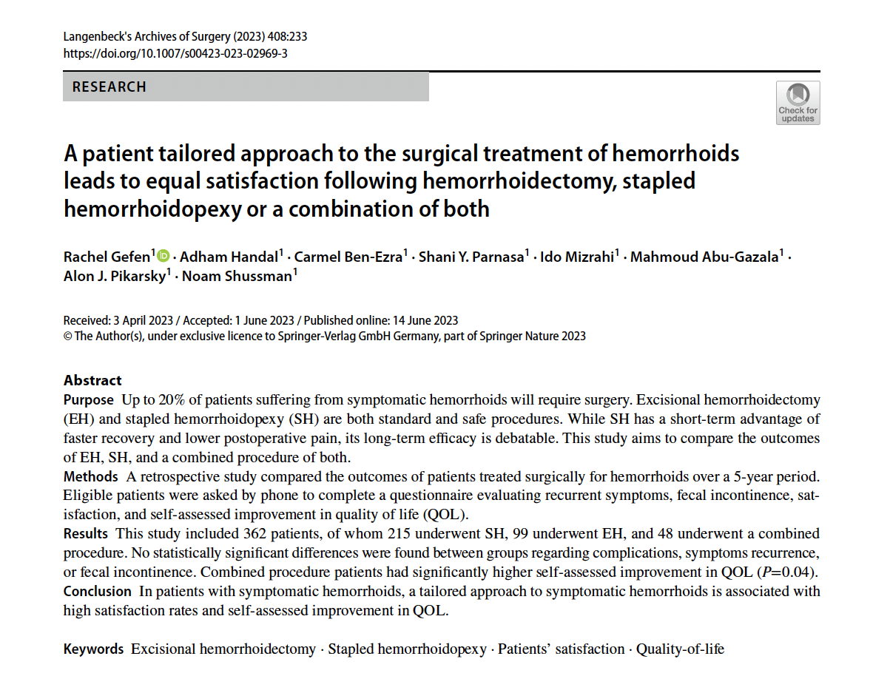

Slide 18
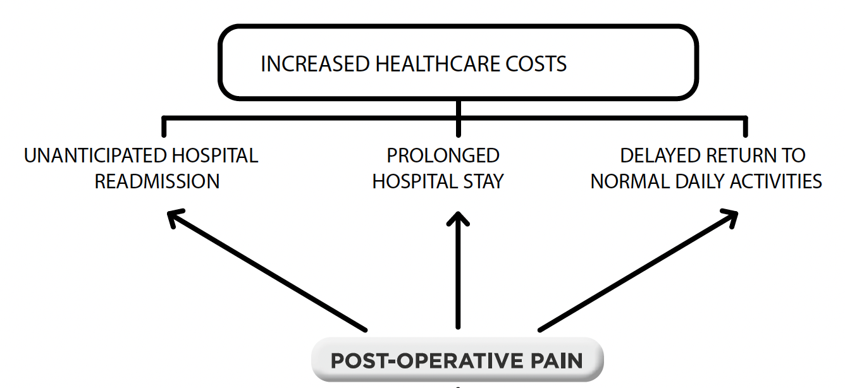
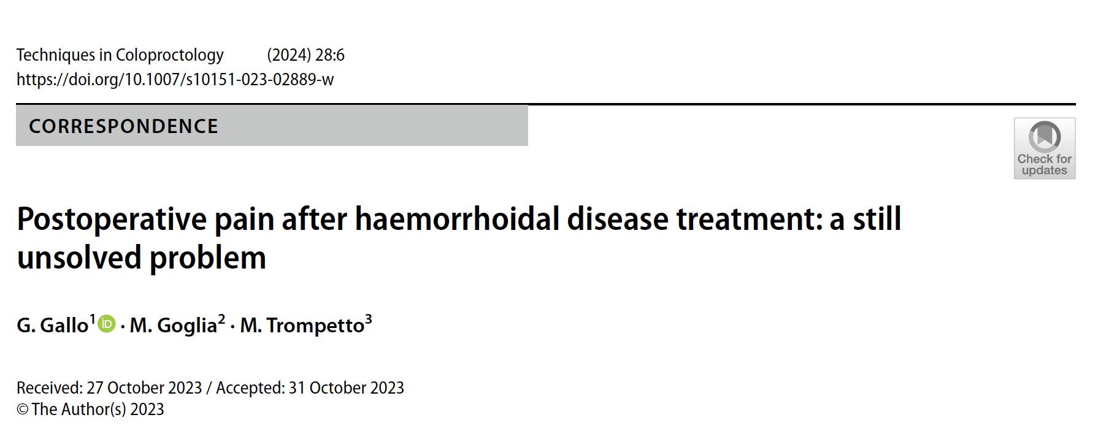
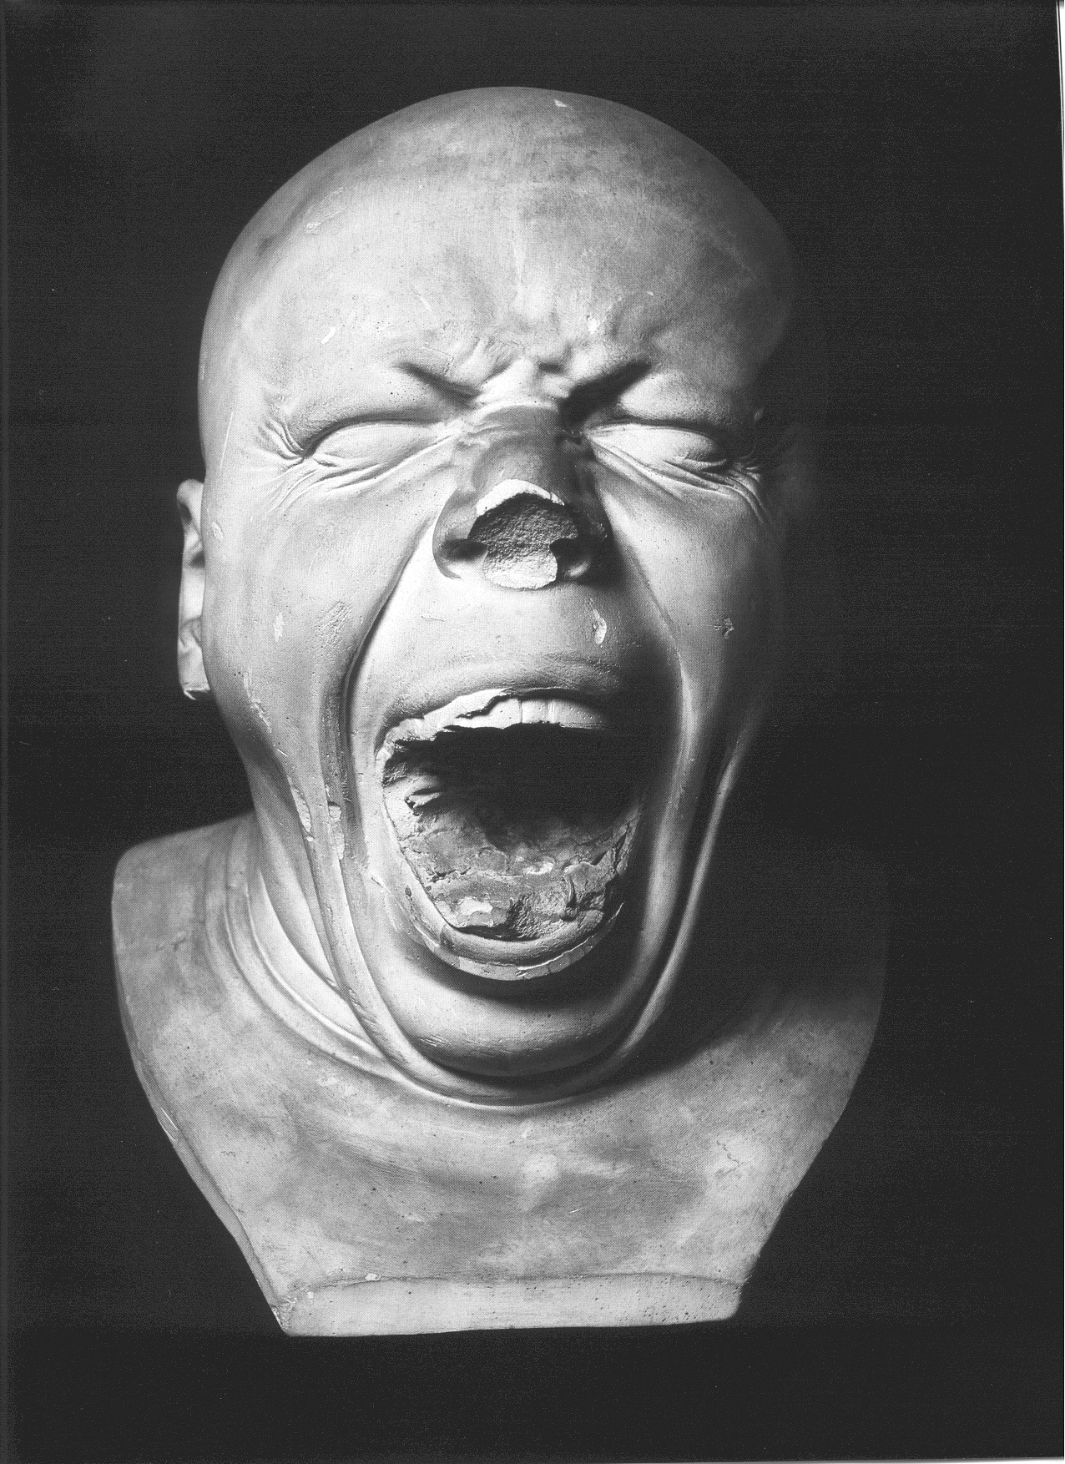
Spasm of the IAS
Eccessive packing in to the anus
Swelling of the wound
Edema/thrombosis of the mucocutaneous bridge
Wound infection
Anal fissure
Notes:
Lastly, Post-operative Pain
In order to avoid pp allowing a fast return to normal activities
Indeed, the main and most common drivers of postoperative pain after conventional excisional haemorrhoidectomy (i.e. Milligan-Morgan or Ferguson) are the incorporation of sensitive mucosa and strands of the internal anal sphincter (IAS) in haemorrhoid pedicle ligatures and the denuding the anal canal of its epithelium with a consequent spasm of the IAS, the presence of tubes and packs, the swelling of the wound, the occurrence of an anal fistula or fissure, and the infection of the wound.
Calcium channel blockers act by inhibiting the flow of Ca2+ into the sarcoplasm of the smooth muscle, therefore promoting sphincter relaxation. As already mentioned,
decrease of the internal sphincter spasm plays a role in pain relief when combined with topical analgesia. Moreover, nifedipine has also been shown to have anti-inflammatory properties as well as the ability to modulate the microcirculation leading to the decrease of the inflammation-related sphincter hypertonicity. Interestingly, the ointment appears to act locally on the IAS, with very limited detectable systemic absorption and with no relevant local or systemic adverse events, arrhythmias or significant ECG changes reported

Slide 19
Notes:
19esimo secolo
was a surgeon at various hospitals in Manchester
Whitehead was particularly noted for the invention of two surgical procedures, both of which bear his name. The first related to the surgical removal of haemorrhoids and was described in the BMJ in 1882, with a further study of 300 patients being published in 1887.^{[28]} The technique is rarely used now because it usually left a deformity, which also bore his name, but this is because those performing the operation misunderstood his description of it.
He highlighted that no skin sacrifices would have occurred. The operation gained wide popularity in the following decades, which gradually decreased in the 20th century due to
the high rate of complications reported, such as anal stenosis, incontinence, or persistent soiling due to mucosal ectropion and deformity (also called “Whitehead’s anus”)
Probably, the poor results of this operation are often the consequence of an incorrect technique, such as excision of the skin or misidentification of the mucocutaneous junction, corresponding
to the dentate line, that some surgical texts between the mid- 1800s and the first half of the 1900s erroneously identified with the white line of Hilton or the intersphincteric line, 1.3 cm on average distally located (38). “Mistaking the white line of Hilton for the mucocutaneous junction would mean the difference between good results and mucosal ectropion or a stricture” (39).

Slide 20

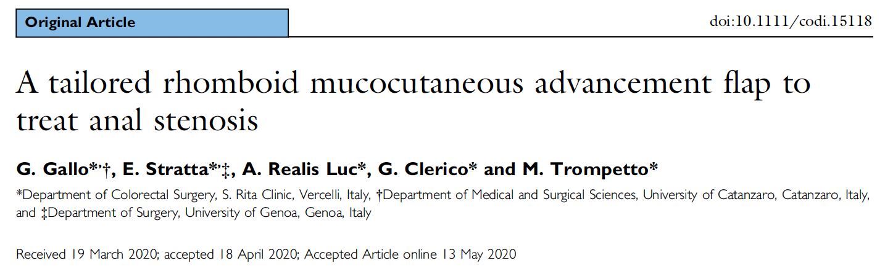
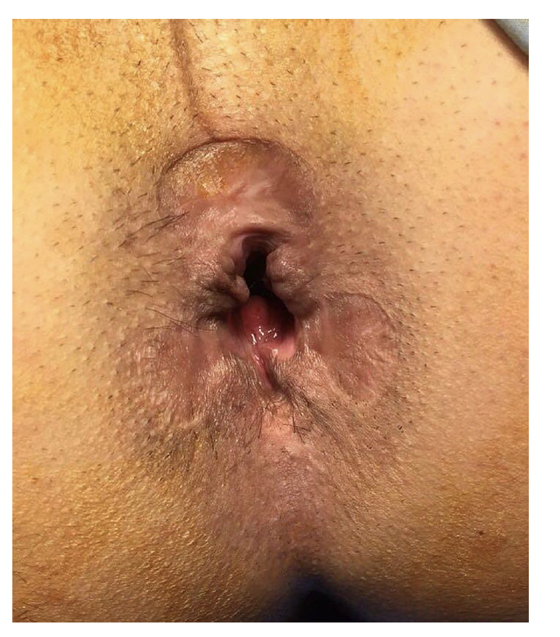
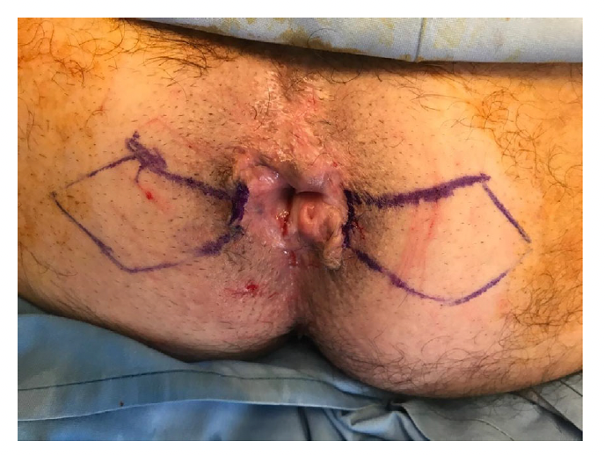
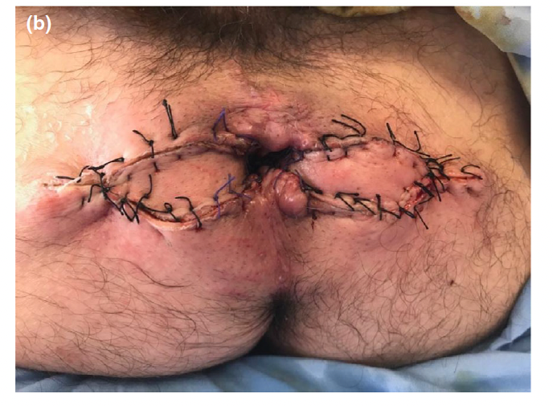
Notes:
68-year-old man presented to our outpatient clinic with a
history of faecal incontinence.
The patient had had a typical three-piles Milligan–Morgan
haemorrhoidectomy 25 years earlier for grade III haemorrhoids.
Furthermore, a posterior sphincterotomy, resulting
in a key-hole deformity, had been performed (Fig. 1).
His medical history was unremarkable. Anorectal manometry
showed a reduction in both rest and squeeze sphincter
pressures associated with impaired rectoanal coordination.
Endoanal ultrasound showed an internal sphincter injury.
The patient underwent sacral neurostimulation, through
the S3 sacral foramen, with a 65% improvement of the faecal
incontinence.
Open excisional haemorrhoidectomy marked the twentieth
century and is still the gold standard for grade III and
grade IV haemorrhoids [1]. However, a step-up-approach
avoiding an unnecessary removal of the piles as well as the
potential side effects, such as a poor sphincter function or
anal stenosis, should be considered especially considering
the current technological evolution and the less invasive
options [1]. Posterior sphincterotomy should be discouraged

Slide 21
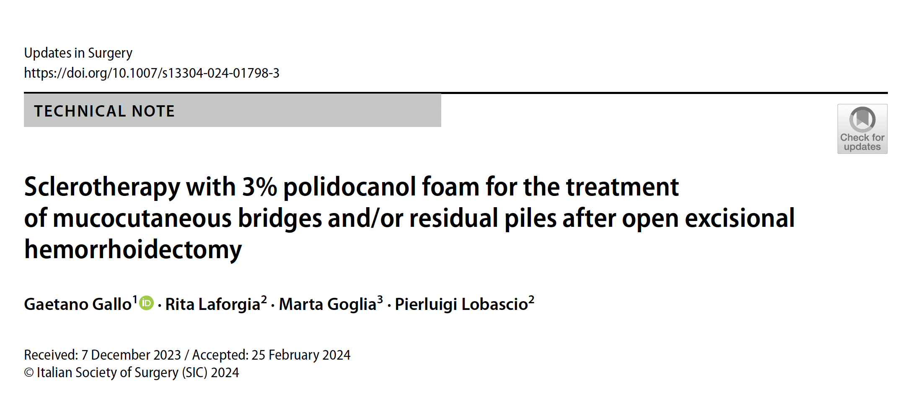
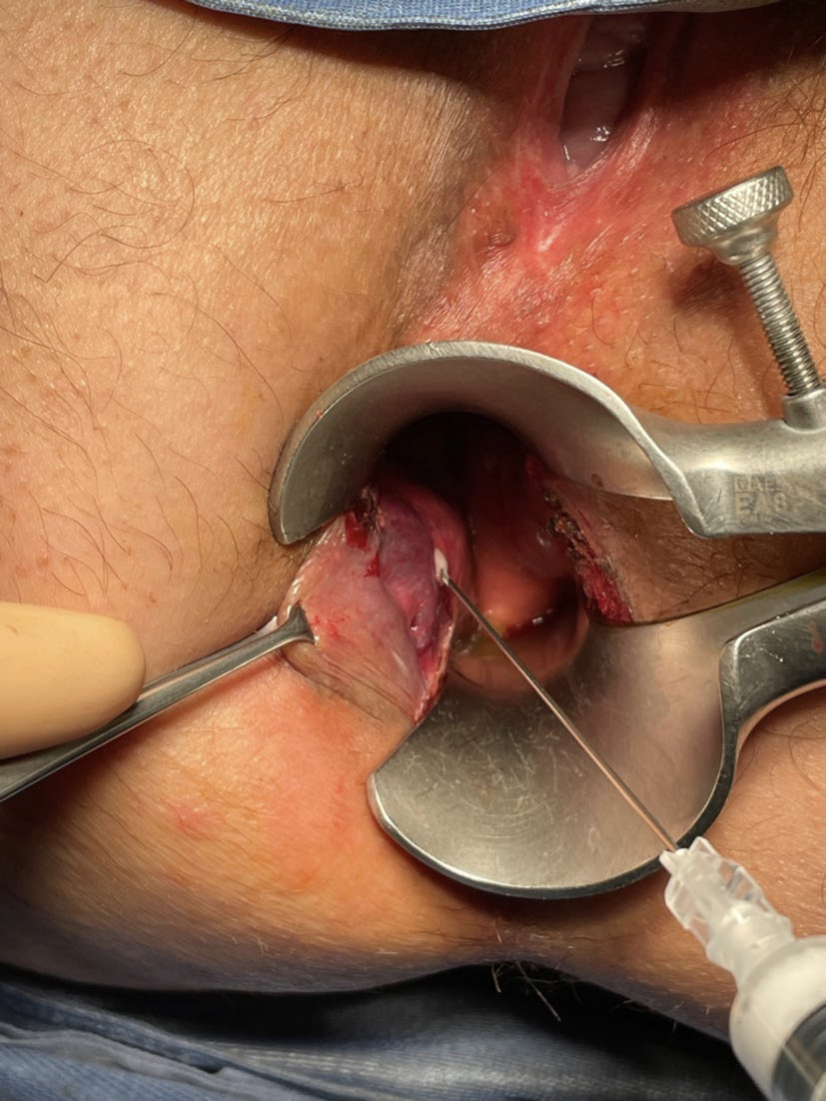
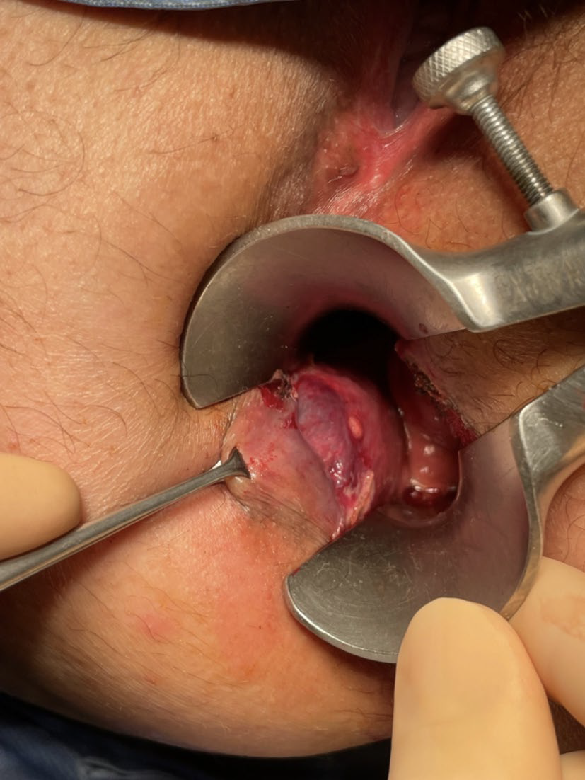

Slide 22


Slide 23
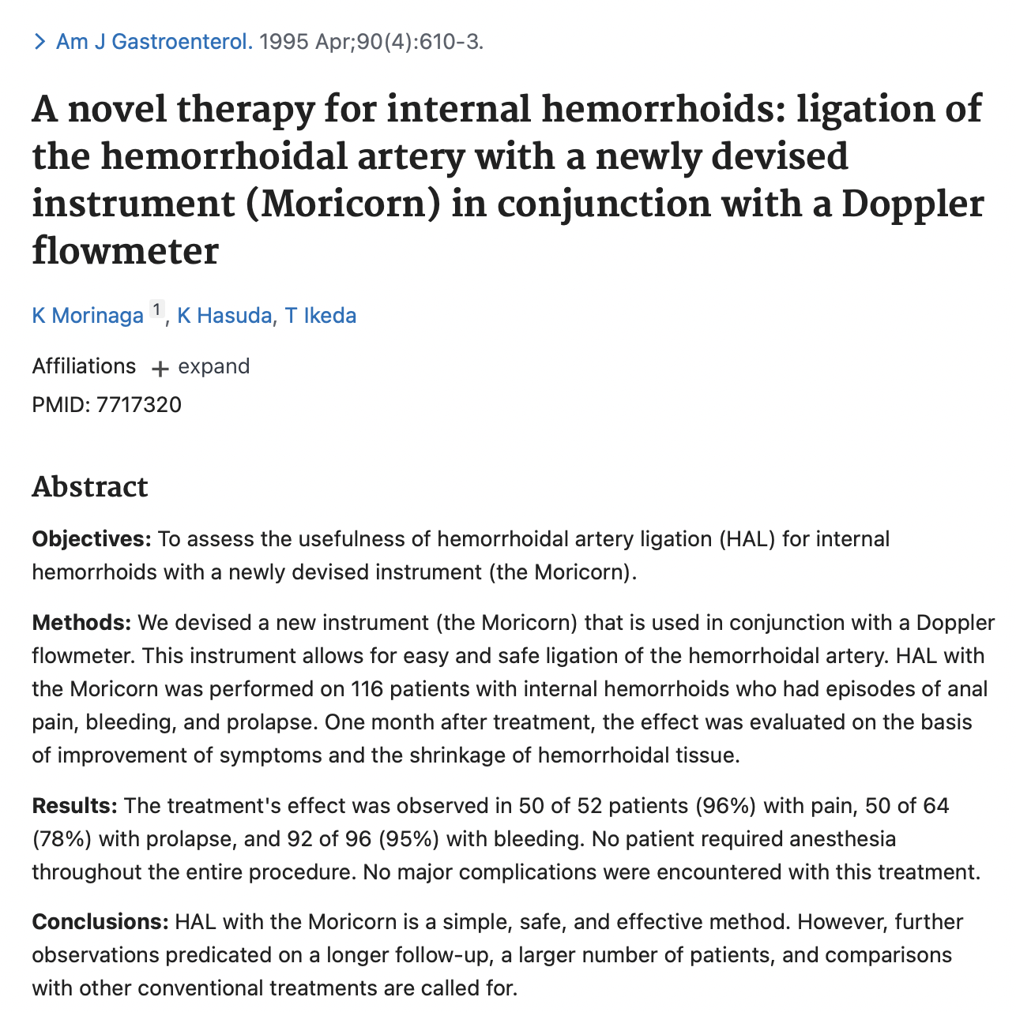
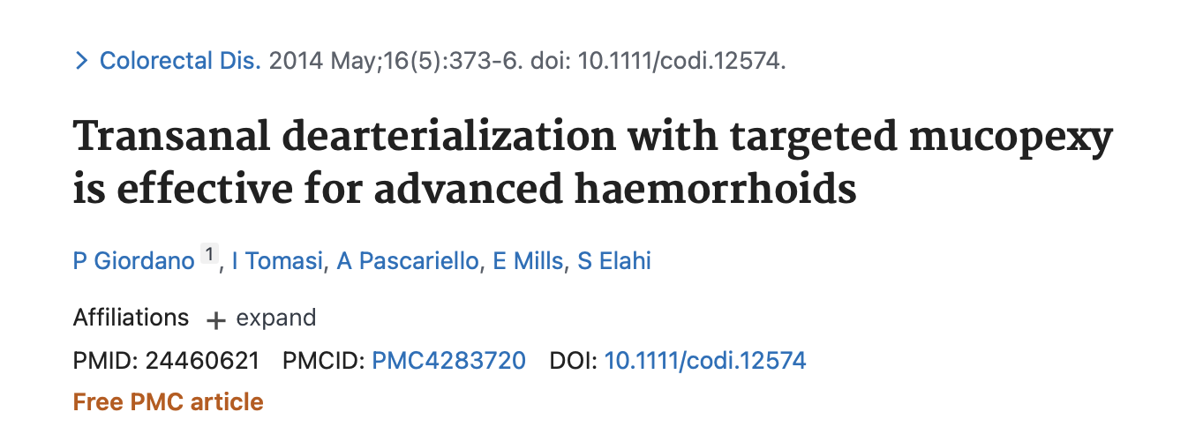
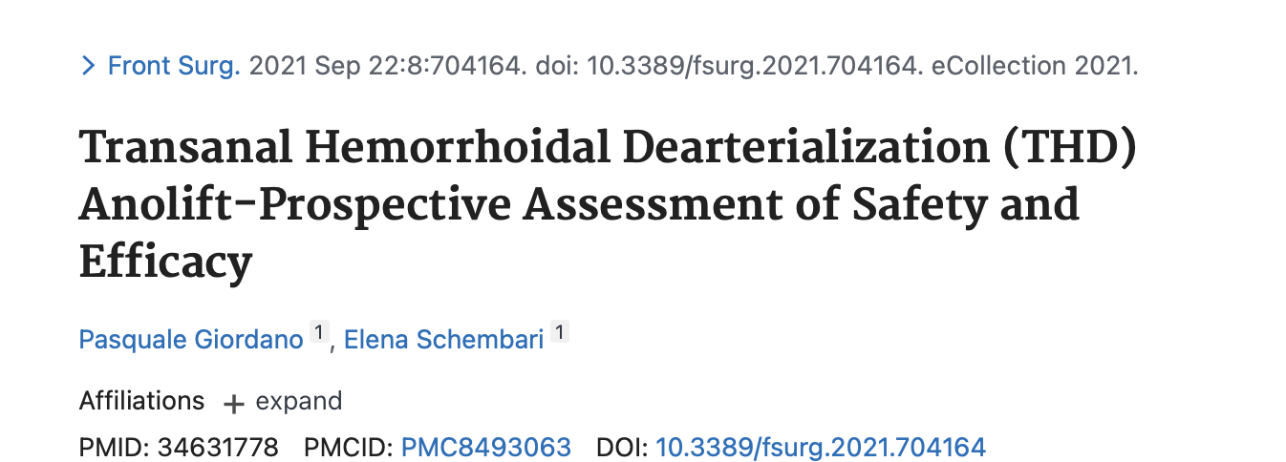
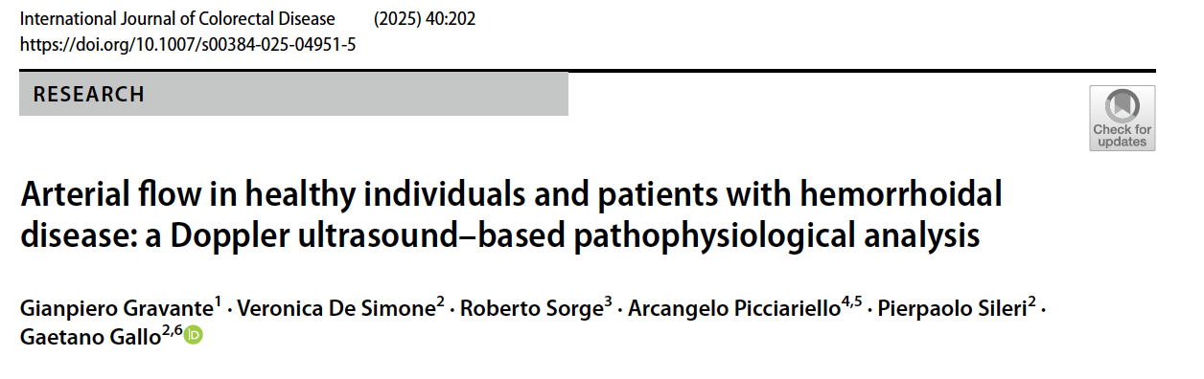

Slide 24


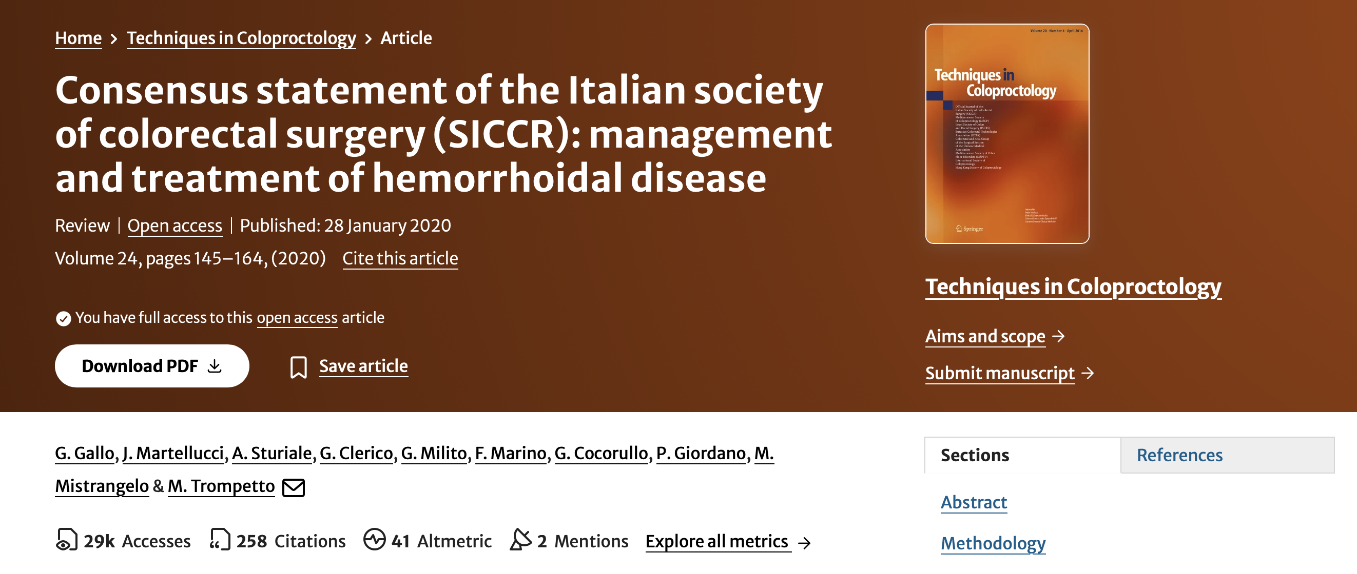
IBD
Immunosuppressed patients
Sexually transmitted diseases
Pregnancy
Radiation Proctitis
Thrombosed External or Internal Hemorrhoids

Slide 25




  CONCLUSION
Where hemorrhoids surgery is concerned, there is no “one size fits all” option
Degree and Size
Symptoms
Patients (Age/Gender/Comorbidities)
Costs
Personal experience and training
Standardization (Mucopexy and Doppler Devices)
Yeo D, Tan KY. Hemorrhoidectomy - making sense of the surgical options. World J Gastroenterol. 2014 Dec 7;20(45):16976-83.
Notes:
In conclusion:

